Slide 1
What is Competitive Programming?
Joshua Ganschow

Slide 2
Introduction
Competitive programming is a contest where participants solve well-defined algorithmic problems within a time limit, applying concepts like data structures and algorithms.
The goal is to write efficient code that solves a given problem correctly while optimizing for time and space complexity.
Skills developed:
Problem solving
Logical thinking
Algorithmic analysis
Notes:
Not only do the competitions provide an avenue for potential employment and networking opportunities, but the process of learning competitive programming itself is helpful for developing skills such as:

Slide 3
Common Problem Types
Greedy Algorithms
Dynamic Programming
Graphs
Sorting and Searching
Math and Number Theory
String manipulation

Slide 4
Greedy Algorithms
Decisions are made step-by-step, choosing the option that seems the best at each step, generally without considering the larger problem or future consequences.
The idea is to pick the locally optimal solution at each stage in hopes of finding a globally optimal solution.
Example: Given a set of coin denominations (1, 5, 10, 25), and a target amount, find the minimum number of coins needed to make the target amount.
Solution: At each step, choose the largest denomination that is less than or equal to the remaining amount
Notes:
Example target: 63 (pick 25, pick 25, pick 10, pick 1 three times)
Limitation: while this approach works for certain coin sets, it might fail for others. For example, you have coins worth (1, 3, or 4) and you need to make 6. The greedy algorithm would choose a 4 and two 1s, but the optimal solution is two 3s

Slide 5
Dynamic Programming
Solve problems by breaking them down into simpler overlapping subproblems and solving each subproblem only once and storing its solution for future use.
Avoids redundant calculations and improves efficiency.
Example: the Fibonacci sequence can be calculated recursively, but we can also use dynamic programming to avoid recalculating the same terms over and over.
By storing the previous values in an array (or list if you prefer), we can avoid unnecessary recalculation.
Notes:
F(5) = F(4) + F(3) = (F(3) + F(2)) + (F(2) + F(1)) results in redundant calculations of values like F(2) and F(3).
Solution shown on next slide

Slide 6
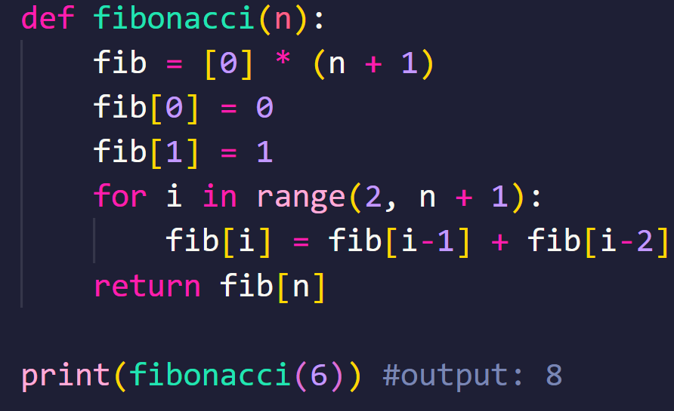
Dynamic Programming Example
Notes:
0, 1, 1, 2, 3, 5, 8

Slide 7
Graphs
Involve solving challenges related to the structure of nodes (vertices) and connections (edges) between them.
Types of graphs:
Directed/Undirected: direction of edges
Weighted/Unweighted: presence of weights on edges
Traversal methods:
BFS
DFS
Dijkstra’s Algorithm
A*

Slide 8
Sorting and Searching
Sorting: arranging data in a specific order, typically ascending or descending.
Searching: finding a specific element within a data structure.
Common Algorithms:
Sorting:
Bubble sort
Insertion sort
Selection sort
Searching:
Linear search
Binary search
Quick Example: “Find the k-th largest element”
Notes:
Given a set of n integers, find the k-th largest element in the set

Slide 9
Sorting and Searching Example
Given a set of n integers and k, find the k-th largest element in the set.
Naïve approach:
Sort and find (sort the array in descending order and return the k-th element).
Optimal for large data:
Use a min-heap of size k to keep track of the K largest elements
Optimal for time efficiency:
Quickselect algorithm; a variation of quick sort.
Partition the array around a pivot and recursively find the k-th largest element.

Slide 10
Math and Number Theory
Involves problems related to arithmetic, divisibility, primes, and modular arithmetic.
Concepts:
GCD & LCM: Greatest Common Divisor and Least Common Multiple
Prime number checking
Modular arithmetic: operations under a modulus.
Common algorithms:
Euclid’s Algorithm: efficiently finds GCD.
Sieve of Eratosthenes: finds all primes up to a given number quickly

Slide 11
String Manipulation
Process of modifying, analyzing, or processing strings.
Basic operations:
Concatenation: “AB” + “AC” = “ABAC”
Substring extraction: retrieving a portion of a string
Searching: finding a specific character or sequence of characters in a string
Replacement: changing specific characters or sequences within a string
Categories:
Basic operations
Searching and matching
Transformations (permutations or rotations)
Advanced concepts (e.g., suffix arrays, tries)
Notes:
Suffix array: sorted array of all suffixes in a string
Trie: a tree used to represent a set of strings as nodes and additional characters as edges

Slide 12
ICPC (International Collegiate Programming Contest)
Teams of 3 with one shared computer
5 hours to solve as many problems as possible
Regional->National->World
Potential rewards: recognition and internship/job opportunities

Slide 13
How to Prepare
Practice
Practice!
PRACTICE!!!!

Slide 14
Tools and Platforms for Practice
Kattis: (open.kattis.com)
Codeforces: (codeforces.com)
ICPC Archive: (icpcarchive.github.io)
Notes:
Kattis: many programming problems and submissions are evaluated automatically by running a series of test cases on the submission.
Codeforces: hosts regular contest (typically two hours) and the contests are categorized by difficulty level
ICPC Archive: archive of past ICPC contests

Slide 15
Why Should You Participate?
Develop problem solving and programming skills.
Competitive programming background is highly valued by tech companies.
Potential internship and scholarship opportunities from competition sponsors of the ICPC.
Also, it’s fun!

Slide 16
Conclusion
Competitive programming can equip you with the necessary skills to succeed.
DSU has many opportunities to participate:
ICPC Qualifier coming up on October 5th
Get a team of three together and let Dr. O’Brien (Austin.Obrien@dsu.edu) know that you would like to participate.
Alternatively, you can sign up with a group of any size and participate for fun.
DigiKey Collegiate Computing Competition (DKC3)
Open to current juniors or seniors (60+ credits completed)
DigiKey recruits heavily for internships and jobs at this event
Questions?

